Slide 1
Introduction to .NET
Florin Olariu
“Alexandru Ioan Cuza”, University of Iași
Department of Computer Science

Slide 2
Agenda
Microservices architecture style
When to use microservices
Microservices benefits
Microservices challenges
CQRS architecture style
When to use CQRS
CQRS benefits
CQRS challenges
CQRS in microservices
Understanding the deployment terminology
Demo

Slide 3
Microservices architecture

Slide 4
Microservices architecture style
A microservices architecture consists of a collection of small, autonomous services.
Each service is self-contained and should implement a single business capability

Slide 5
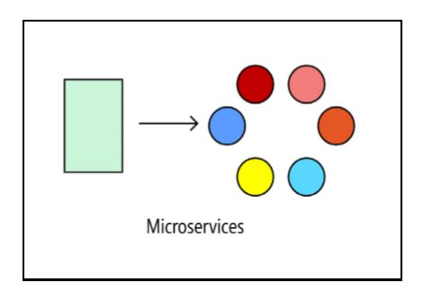
Microservices architecture
Notes:
Services are loosely coupled, communicating through API contracts.
Each service can be built by a small, focused development team.
Individual services can be deployed without a lot of coordination between teams, which encourages frequent updates.

Slide 6
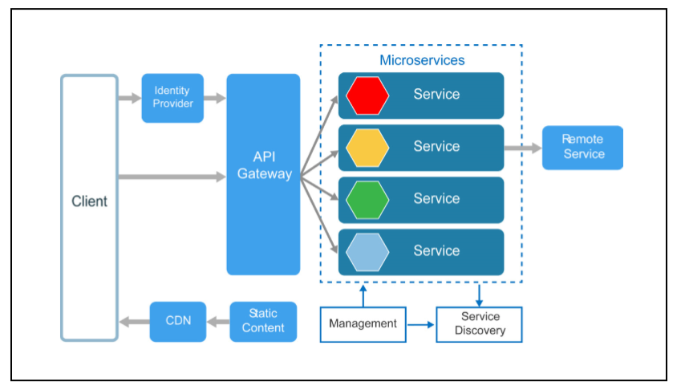
Microservices architecture
Notes:
Management. The management component is responsible for placing services on nodes, identifying failures, rebalancing services across nodes, and so forth.
Service Discovery. Maintains a list of services and which nodes they are located on. Enables service lookup to find the endpoint for a service.
API Gateway. The API gateway is the entry point for clients. Clients don’t call services directly. Instead, they call the API gateway, which forwards the call to the appropriate services on the back end.
The API gateway might aggregate the responses from several services and return the aggregated response.
In some ways, microservices are the natural evolution of service oriented architectures (SOA), but there are differences between microservices and SOA.
Here are some defining characteristics of a microservice:

Slide 7
Microservices architecture
In a microservices architecture, services are small, independent, and loosely coupled.

Slide 8
Microservices architecture
In a microservices architecture, services are small, independent, and loosely coupled.
Each service is a separate codebase, which can be managed by a small development team.

Slide 9
Microservices architecture
In a microservices architecture, services are small, independent, and loosely coupled.
Each service is a separate codebase, which can be managed by a small development team.
Services can be deployed independently. A team can update an existing service without rebuilding and redeploying the entire application.

Slide 10
Microservices architecture
In a microservices architecture, services are small, independent, and loosely coupled.
Each service is a separate codebase, which can be managed by a small development team.
Services can be deployed independently. A team can update an existing service without rebuilding and redeploying the entire application.
Services are responsible for persisting their own data or external state. This differs from the traditional model, where a separate data layer handles data persistence.

Slide 11
Microservices architecture
In a microservices architecture, services are small, independent, and loosely coupled.
Each service is a separate codebase, which can be managed by a small development team.
Services can be deployed independently. A team can update an existing service without rebuilding and redeploying the entire application.
Services are responsible for persisting their own data or external state. This differs from the traditional model, where a separate data layer handles data persistence.
Services communicate with each other by using well-defined APIs. Internal implementation details of each service are hidden from other services.

Slide 12
Microservices architecture
In a microservices architecture, services are small, independent, and loosely coupled.
Each service is a separate codebase, which can be managed by a small development team.
Services can be deployed independently. A team can update an existing service without rebuilding and redeploying the entire application.
Services are responsible for persisting their own data or external state. This differs from the traditional model, where a separate data layer handles data persistence.
Services communicate with each other by using well-defined APIs. Internal implementation details of each service are hidden from other services.
Services don’t need to share the same technology stack, libraries, or frameworks.

Slide 13
When to use microservices
Notes:
Consider this architecture style for:

Slide 14
When to use microservices
Large applications that require a high release velocity.

Slide 15
When to use microservices
Large applications that require a high release velocity.
Complex applications that need to be highly scalable.

Slide 16
When to use microservices
Large applications that require a high release velocity.
Complex applications that need to be highly scalable.
Applications with rich domains or many subdomains.

Slide 17
When to use microservices
Large applications that require a high release velocity.
Complex applications that need to be highly scalable.
Applications with rich domains or many subdomains.
An organization that consists of small development teams.

Slide 18
Microservices benefits

Slide 19
Microservices benefits
Independent deployments. You can update a service without redeploying the entire application, and roll back or roll forward an update if something goes wrong. Bug fixes and feature releases are more manageable and less risky.
Independent development. A single development team can build, test, and deploy a service. The result is continuous innovation and a faster release cadence.
Small, focused teams. Teams can focus on one service. The smaller scope of each service makes the code base easier to understand, and it’s easier for new team members to ramp up.

Slide 20
Microservices challenges

Slide 21
Microservices challenges
Complexity. A microservices application has more moving parts than the equivalent monolithic application. Each service is simpler, but the entire system as a whole is more complex.
Notes:
https://en.wikipedia.org/wiki/Eventual_consistency

Slide 22
Microservices challenges
Complexity. A microservices application has more moving parts than the equivalent monolithic application. Each service is simpler, but the entire system as a whole is more complex.
Data integrity. With each microservice responsible for its own data persistence. As a result, data consistency can be a challenge. Embrace eventual consistency where possible.
Notes:
https://en.wikipedia.org/wiki/Eventual_consistency

Slide 23
Microservices challenges
Complexity. A microservices application has more moving parts than the equivalent monolithic application. Each service is simpler, but the entire system as a whole is more complex.
Data integrity. With each microservice responsible for its own data persistence. As a result, data consistency can be a challenge. Embrace eventual consistency where possible.
Skillset. Microservices are highly distributed systems. Carefully evaluate whether the team has the skills and experience to be successful.
Notes:
https://en.wikipedia.org/wiki/Eventual_consistency

Slide 24
CQRS architecture style

Slide 25
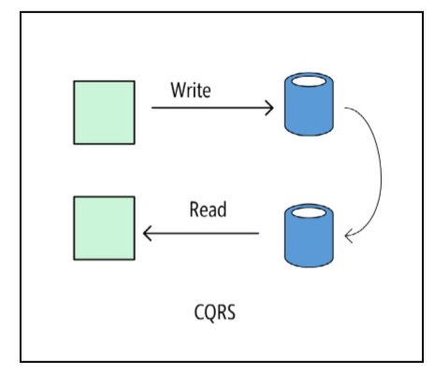
CQRS architecture style
Notes:
The CQRS (Command and Query Responsibility Segregation) style separates read and write operations into separate models.
This isolates the parts of the system that update data from the parts that read the data.
Moreover, reads can be executed against a materialized view that is physically separate from the write database.
That lets you scale the read and write workloads independently, and optimize the materialized view for queries.

Slide 26
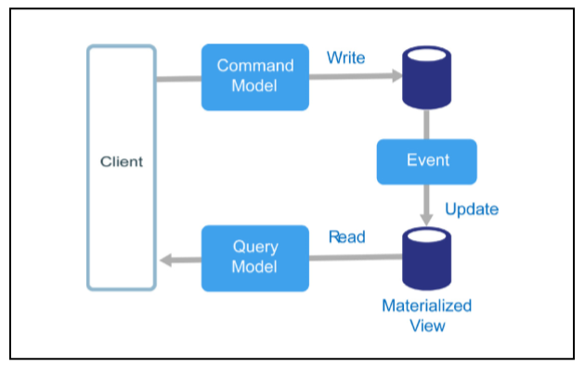
CQRS architecture style
Notes:
In traditional architectures, the same data model is used to query and update a database.
That’s simple and works well for basic CRUD operations.
In more complex applications, however, this approach can become unwieldy.
For example, on the read side, the application may perform many different queries, returning data transfer objects (DTOs) with different shapes.
Object mapping can become complicated.
On the write side, the model may implement complex validation and business logic.
As a result, you can end up with an overly complex model that does too much.

Slide 27
CQRS architecture style
Commands should be task based, rather than data centric. (“Book hotel room,” not “set ReservationStatus to Reserved.”) Commands may be placed on a queue for asynchronous processing, rather than being processed synchronously.
Queries never modify the database. A query returns a DTO that does not encapsulate any domain knowledge.

Slide 28
When to use CQRS

Slide 29
When to use CQRS
Consider CQRS for collaborative domains where many users access the same data, especially when the read and write workloads are asymmetrical. CQRS is not a top-level architecture that applies to an entire system.

Slide 30
When to use CQRS
Consider CQRS for collaborative domains where many users access the same data, especially when the read and write workloads are asymmetrical. CQRS is not a top-level architecture that applies to an entire system.
Apply CQRS only to those subsystems where there is clear value in separating reads and writes. Otherwise, you are creating additional complexity for no benefit.

Slide 31
CQRS benefits

Slide 32
CQRS benefits
Independently scaling. CQRS allows the read and write workloads to scale independently, and may result in fewer lock contentions.

Slide 33
CQRS benefits
Independently scaling. CQRS allows the read and write workloads to scale independently, and may result in fewer lock contentions.
Separation of concerns. Segregating the read and write sides can result in models that are more maintainable and flexible. Most of the complex business logic goes into the write model. The read model can be relatively simple.
Notes:
https://docs.microsoft.com/en-us/sql/relational-databases/views/create-indexed-views

Slide 34
CQRS benefits
Independently scaling. CQRS allows the read and write workloads to scale independently, and may result in fewer lock contentions.
Separation of concerns. Segregating the read and write sides can result in models that are more maintainable and flexible. Most of the complex business logic goes into the write model. The read model can be relatively simple.
Simpler queries. By storing a materialized view in the read database, the application can avoid complex joins when querying.
Notes:
https://docs.microsoft.com/en-us/sql/relational-databases/views/create-indexed-views

Slide 35
CQRS challenges

Slide 36
CQRS challenges
Complexity. The basic idea of CQRS is simple. But it can lead to a more complex application design, especially if they include the Event Sourcing pattern.

Slide 37
CQRS challenges
Complexity. The basic idea of CQRS is simple. But it can lead to a more complex application design, especially if they include the Event Sourcing pattern.
Messaging. Although CQRS does not require messaging, it’s common to use messaging to process commands and publish update events. In that case, the application must handle message failures or duplicate messages.

Slide 38
CQRS challenges
Complexity. The basic idea of CQRS is simple. But it can lead to a more complex application design, especially if they include the Event Sourcing pattern.
Messaging. Although CQRS does not require messaging, it’s common to use messaging to process commands and publish update events. In that case, the application must handle message failures or duplicate messages.
Eventual consistency. If you separate the read and write databases, the read data may be stale.

Slide 39
CQRS in microservices

Slide 40
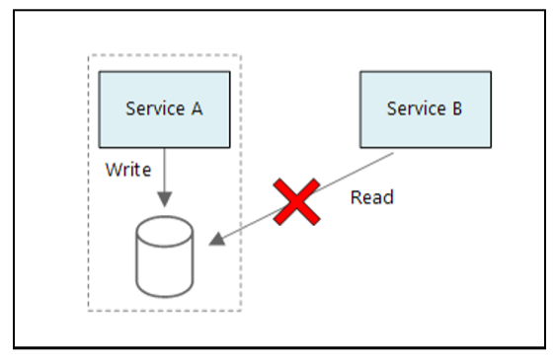
CQRS in microservices
Notes:
CQRS can be especially useful in a microservices architecture.
One of the principles of microservices is that a service cannot directly access another service’s data store.

Slide 41
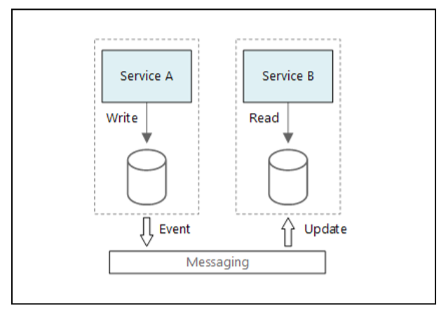
CQRS in microservices
Notes:
In the following diagram, Service A writes to a data store, and Service B keeps a materialized view of the data.
Service A publishes an event whenever it writes to the data store. Service B subscribes to the event

Slide 42
Understanding the deployment terminology

Slide 43
Understanding the deployment terminology
Build: In the build stage, the service source gets compiled without any errors along with the passing of all corresponding unit tests. This stage produces build artifacts.

Slide 44
Understanding the deployment terminology
Build: In the build stage, the service source gets compiled without any errors along with the passing of all corresponding unit tests. This stage produces build artifacts.
Continuous Integration (CI): CI forces the entire application to build again every time a developer commits any change—the application code gets compiled and a comprehensive set of automated tests are run against it. This practice emerged from the problems of frequent integration of code in large teams. The basic idea is to keep the delta, or change to the software, small. This provides confidence that the software is in a workable state. Even if a check-in made by a developer breaks the system, it is easy to fix it this way.

Slide 45
Understanding the deployment terminology
Deployment: Hardware provisioning and installing the base OS and correct version of the .NET framework are prerequisites for deployment. The next part of it is to promote these build artifacts in production through various stages. The combination of these two parts is referred to as the deployment stage. There is no distinction between the deployment and release stage in most monolithic applications.

Slide 46
Understanding the deployment terminology
Deployment: Hardware provisioning and installing the base OS and correct version of the .NET framework are prerequisites for deployment. The next part of it is to promote these build artifacts in production through various stages. The combination of these two parts is referred to as the deployment stage. There is no distinction between the deployment and release stage in most monolithic applications.
Continuous Deployment (CD): In CD, each successful build gets deployed to production. CD is more important from a technical team's perspective. Under CD, there are several other practices, such as automated unit testing, labeling, versioning of build numbers, and traceability of changes. With continuous delivery, the technical team ensures that the changes pushed to production through various lower environments work as expected in production. Usually, these are small and deployed very quickly.

Slide 47
Understanding the deployment terminology
Continuous delivery: Continuous delivery is different from CD. CD comes from a technical team's perspective, whereas continuous delivery is more focused on providing the deployed code as early as possible to the customer. To make sure that customers get the right defect-free product, in continuous delivery, every build must pass through all the quality assurance checks. Once the product passes the satisfactory quality verification, it is the business stakeholders' decision when to release it.

Slide 48
Understanding the deployment terminology
Continuous delivery: Continuous delivery is different from CD. CD comes from a technical team's perspective, whereas continuous delivery is more focused on providing the deployed code as early as possible to the customer. To make sure that customers get the right defect-free product, in continuous delivery, every build must pass through all the quality assurance checks. Once the product passes the satisfactory quality verification, it is the business stakeholders' decision when to release it.
Build and deployment pipelines: The build and deployment pipeline is part of implementing continuous delivery through automation. It is a workflow of steps through which the code is committed in the source repository. At the other end of the deployment pipeline, the artifacts for release are produced. Some of the steps that may make up the build and deployment pipeline are as follows:

Slide 49
Understanding the deployment terminology
Continuous delivery: Continuous delivery is different from CD. CD comes from a technical team's perspective, whereas continuous delivery is more focused on providing the deployed code as early as possible to the customer. To make sure that customers get the right defect-free product, in continuous delivery, every build must pass through all the quality assurance checks. Once the product passes the satisfactory quality verification, it is the business stakeholders' decision when to release it.
Build and deployment pipelines: The build and deployment pipeline is part of implementing continuous delivery through automation. It is a workflow of steps through which the code is committed in the source repository. At the other end of the deployment pipeline, the artifacts for release are produced. Some of the steps that may make up the build and deployment pipeline are as follows:
1)Unit tests
2) Integration tests
3) Code coverage and static analysis
4) Regression tests
5) Deployments to staging environment
6) Load/stress tests
7) Deployment to release repository

Slide 50
Understanding the deployment terminology
Release: A business feature made available to the end user is referred to as the release of a feature. To release a feature or service, the relevant build artifacts should be deployed beforehand. Usually, the feature toggle manages the release of a feature. If the feature flag (also called feature toggle) is not switched on in production, it is called a dark release of the specified feature.

Slide 51
One more thing…

Slide 52
One more thing…
Rules of Optimization: Rule 1: Don't do it. Rule 2 (for experts only): Don't do it yet.

Slide 53
Bibliography
Pluralsight
Application Architecture Cloud Guide - Microsoft

Slide 54
Questions
Do you have any other questions?

Slide 55
Thanks!
See you next time! ☺

